Slide 1

Restaurant Risk Prediction using Machine Learning Algorithms
Presented by, Aman Patel Kamal Panchal Kuldip Patel Shripal Shah Under the Guidance of, Dr. Vishnu Pendyala
Image Source: northernvirginiamag.com

Slide 2
Motivation
Food-borne illnesses can be prevented through restaurant inspections.
Restaurants in high-risk categories will be regularly inspected, and future risk categories will be predicted.
A lot of human resources are required to monitor and maintain restaurant violations.
By using various features in the data, this project will be able to automatically classify restaurants into a low, medium, or high-risk category based on different characteristics found in the data.
This project will teach us how to integrate machine learning algorithms into real-life use cases.

Slide 3
Objective
The main objective of this project is to predict restaurant risk using various machine learning algorithms.
Our project focuses on predicting restaurant risk categories using data from the San Francisco government.
In order to improve training and test sets, this project involves detailed steps in preprocessing data, such as detecting null values, noise, and outliers.
Following the post-processing, the data is divided into training and testing datasets for the model.
It involves considering and training algorithms from a wide range of machine-learning families.
We measure algorithms' performance using accuracy, recall, precision, and F1 scores.

Slide 4
Literature Survey
Restaurant Rating Prediction Using Regression : In this paper, the author validate predicted Ratings for New Restaurants. They compare various options for a particular characteristic of a planned Restaurant based on multiple factors that are characteristics of the planned restaurant. Opening a new restaurant can also help one make the right decisions. Thus, protecting them against investment losses, saving time, and making the whole process a calculated risk. Predictions are made using seven different regression models by analyzing factors that can be controlled easily before setting up a new restaurant. Finally, model metrics are compared to select the best regression model.
Grey prediction model-based food security early warning prediction : This paper proposes an early warning system for food. First, a gray prediction model improved, and a quality index is constructed. Food quality is measured using the quality index model. Following that, a gray prediction model is applied to predict the future trend of food quality indexes. Finally, the food security risk is assessed by comparing predicted trends with standard limits proposed by experts. Taking measures to protect people's health from the risks associated with risky foods.

Slide 5
Literature Survey (Cont.)
Ensemble Learning Models for Food Safety Risk prediction : To improve border inspection methods for imported food, ensemble learning was used to develop risk prediction models. It was intended to increase the hit rate of non-conforming products so that border control of food products can be strengthened to protect public health. We developed models using five algorithms to assess each imported food batch's risk. As a way of evaluating the models, a confusion matrix was constructed to calculate predictive performance indicators, such as positive predictive value (PPV), recall, the harmonic mean of PPV and recall (F1 score), and the area under the curve. The ensemble model predict the risk more effectively.

Slide 6
Methodology
In our project, we first use the ETL technique on the dataset for data extraction.
Once the data is extracted, the data is pre-processed for the models to train.
Once we clean the data, we make a feature selection for our ML models.
Once the features are selected, they are divided into training and testing.
The ML models are trained on the training dataset and tested using the testing dataset.
The performance of the models is calculated using the accuracy, recall, precision, and F1 scores.

Slide 7
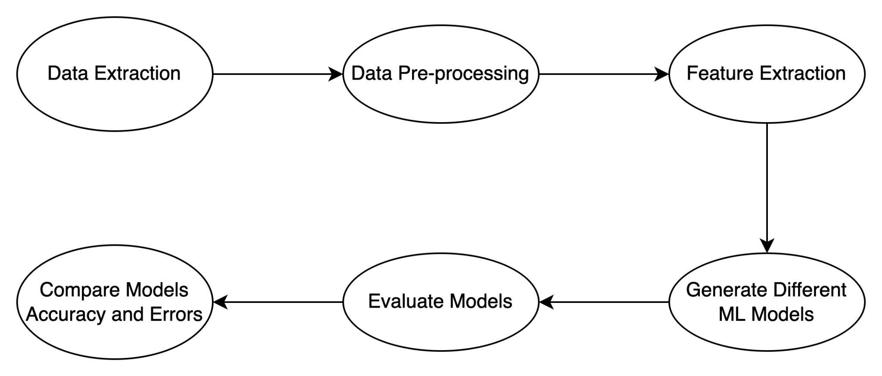
Methodology (Cont.)
The schematic representation of the methodology
Process Flow Chart

Slide 8
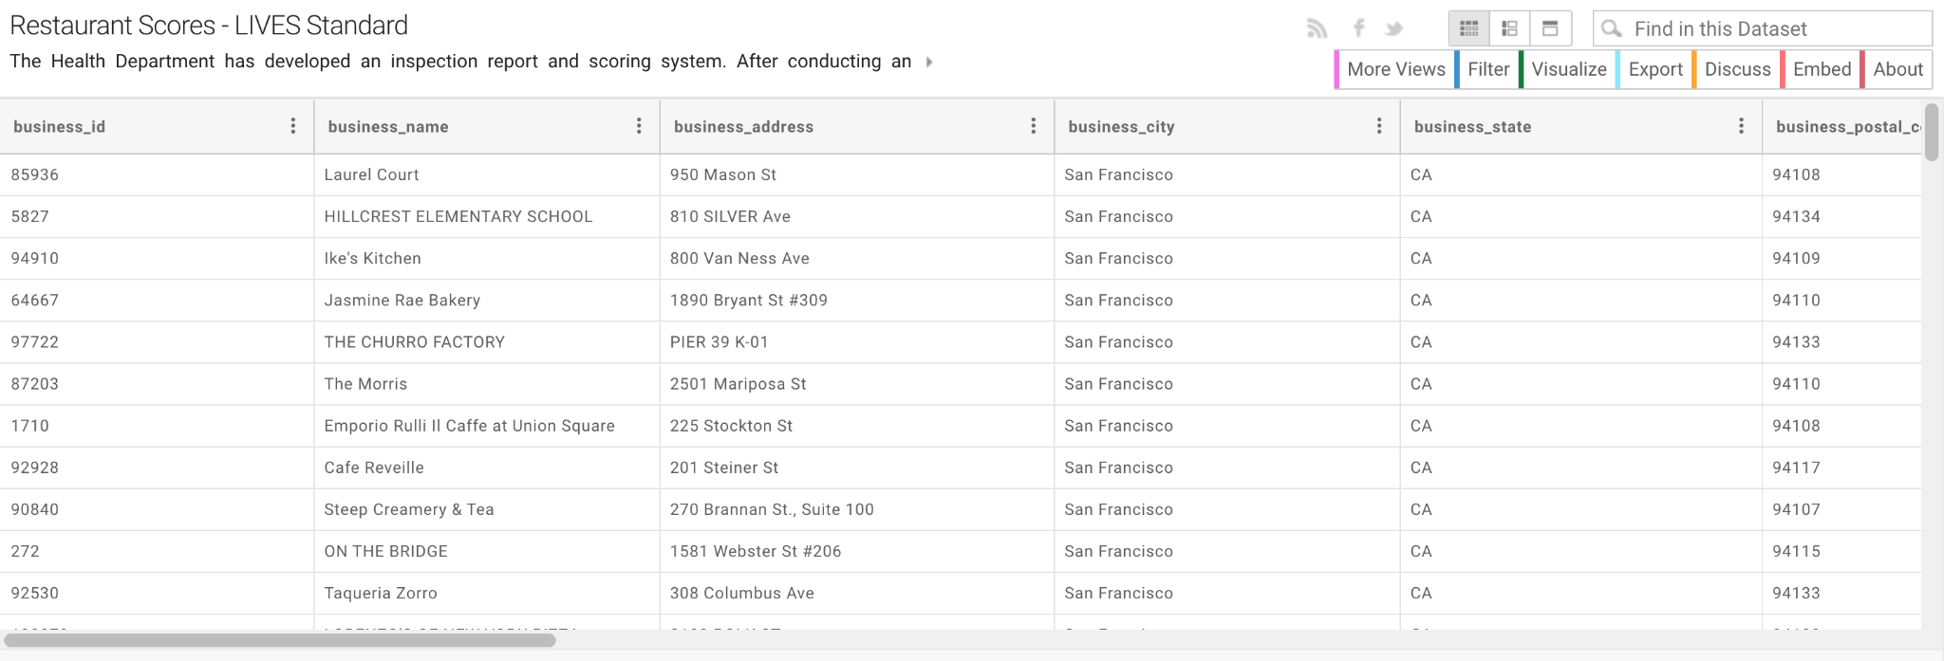
Data Collection
We are going to use a dataset from the DataSF site, which is a public source of data mainly gathered from the YELP LIVES project and San Francisco Government data which updates yearly.
The dataset comprises of 17 columns and 53.7K rows.

Slide 9
Data Preprocessing
Preprocessing consists of converting each column's data type into a specific one.
All the columns will be converted to numerical data types in our approach.
A lot of noisy data is removed, redundant data from specific columns were removed to help model train better.
Some of the detailed process of data preprocessing are :
business_name: This column had a list of restaurant name. However the restaurant can be uniquely identified by business_id we dropped this column
business_address: This column had address of the restaurant. However we have the postal code, latitude and longitude we dropped this column
business_city: The business city in the whole dataset was San Francisco. Due to its limited contribution to training, it was removed from the table.
business_state: In the entire dataset, California was observed to be the business state. Due to its inability to contribute to the training of data, this column was removed.

Slide 10
Data Preprocessing (Cont.)
business_phone_number: This column does not looked much important to find our prediction so it was dropped
inspection_date was broken into three columns year,month and day for training the model in a better way.
Many rows with the null values, missing values, with different string literal values were dropped.
After all the preprocessing we were left with 20.2K row and 12 columns for training and testing.

Slide 11
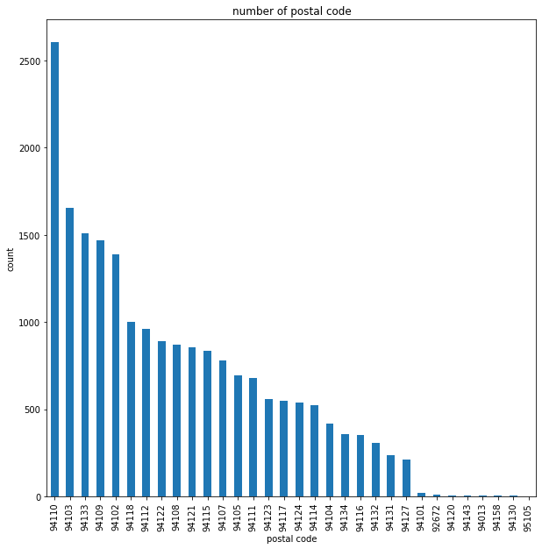
Data Visualization
business_postal_code vs. count plot, Fig.1, Compared to other postal codes, only a few have very low densities and relative data.
Fig. 1 Plot between business_postal_code vs count relationship

Slide 12
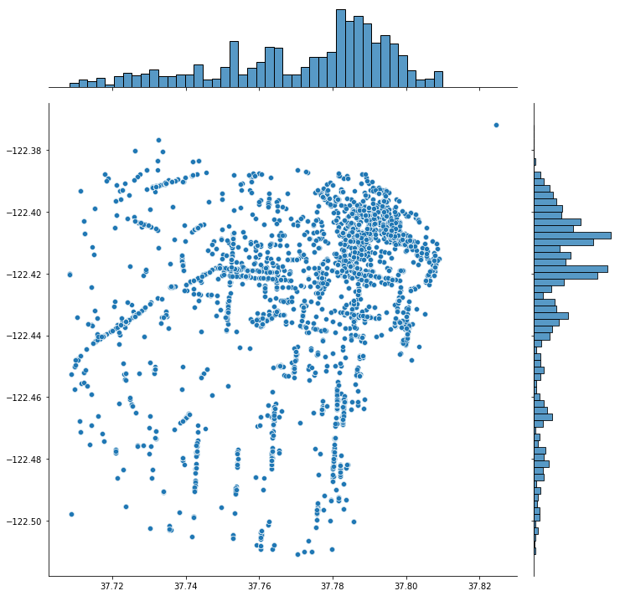
Data Visualization
Latitude vs Longitude plot Fig. 2, Restaurants run their businesses in certain regions, which are hotspots. For this reason, it would be interesting to predict a restaurant's risk category based on its location.
Fig. 2 Plot between Latitude vs Longitude

Slide 13
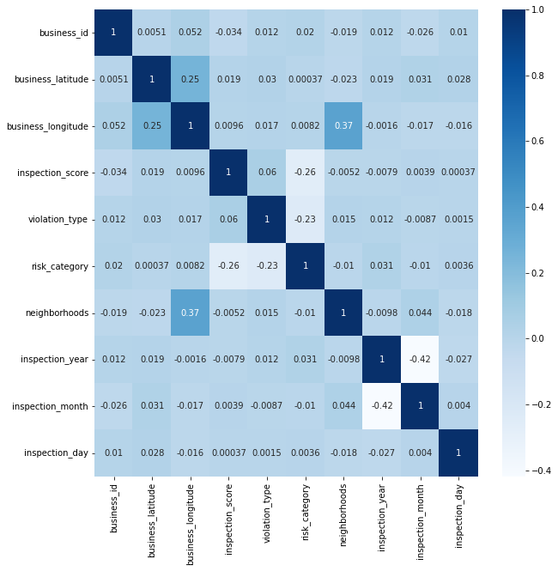
Data Visualization
Correlation between features, Fig.3, Correlation between all the numerical features after the pre processing
Fig. 3 Correlation between features

Slide 14
Data Preparation and Evaluation
Data Preparation:
To train our models we split the data set in two separate dataset that is training and testing dataset with the ratio of 80:20
The training dataset consist of 16.2K row and the testing dataset consist of 4K rows
Evaluation:
Once the training of the model is finished we evaluate our model on the basis of performance parameter like confusion matrix, recall, precision, and accuracy.

Slide 15
Models and Algorithms
We are using 4 models with different machine learning algorithms in each model which are as follows:
Linear Model
Geometric Model
Probabilistic Model
Logical Model

Slide 16
Linear Model
As the name implies, linear models are described as linear combinations of features.
Linear models use a line equation to fit data, where a decision boundary is calculated to classify differences between classes.
As a result of the learning process, each feature is given a certain weight in order to build a model that is capable of predicting or classifying the target value.
We are using Logistic regression as our linear model in our project.
In this regression task we use logistic function to train the model.
As a result the output value for this model is a binary value.
We implement logistic regression using newton-cg solver

Slide 17
Geometric Model
In this model regression and classification models rely on geometry knowledge such as hyperplanes, linear transformations, and distance metrics.
In this model we are using the K- Nearest neighbours algorithm.
In the nearest neighbor method, training samples are found closest in distance to a new point and classes are predicted from them.
We are calculating the distance using two methods:
Manhattan Distance
Euclidean Distance

Slide 18
Probabilistic Model
The probability distribution is used to model probabilistic model.
Data uncertainty is reduced by these model.
In this model we are using Gaussian Naïve Bayes model.
We can use prior knowledge to choose the most probable hypothesis about the data.
Based on prior knowledge, bayes theorem allows us to calculate the probability of a hypothesis.

Slide 19
Logical Model
These models are defined in terms of easily interpretable logical expressions.
Using boolean logic, these models label leaves using either majority or proportional systems.
In this model we are using Decision Tree Classifier.
In a decision tree classifier, information gain plays a key role in dividing classes.
To divide the classes at each level of the tree, the one that gives the most information gain is selected.

Slide 20
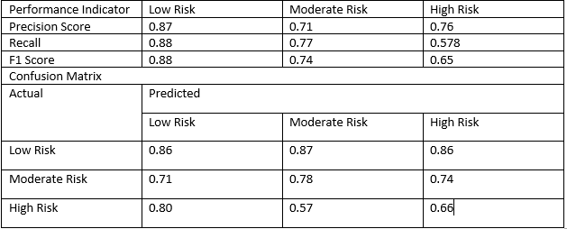
Results
Linear Model
When training logistic regression models with solvers like Newton-cg produced accuracy better 73%, it was not possible to identify the decision limit that can be classified by risk category.

Slide 21
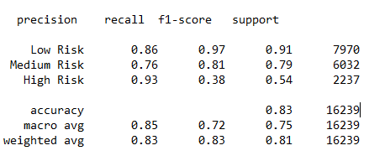
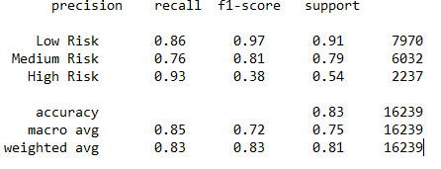
Results (Cont.)
Geometric Model
K-Nearest Neighbors, which uses Manhattan and Euclidean distance, is the method used by the two trained models. The initial model that took Manhattan's distance into account produced some rather good findings. It was 82% accurate on average.

Slide 22
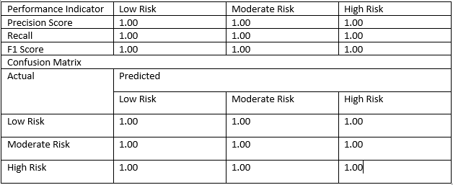
Results (Cont.)
Logical Mode
The logic model decision tree classifier was trained using the maximum depth of fault; the average accuracy of the tree ranges from 92% to 98%, which is also the sign of overfitting.

Slide 23
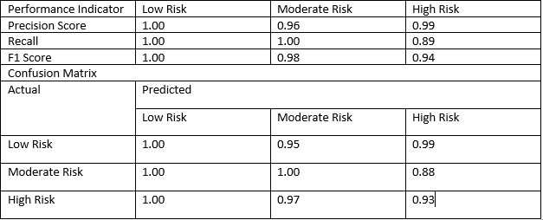
Results (Cont.)
Probabilistic Model
In the probabilistic model, we trained Gaussian Naïve Bayes. With an average accuracy of 98\%, this model did well. It is over-fitted because the accuracy after training and cross-validation stays at 98%.

Slide 24
Conclusion
Our approach made an effort to divide restaurants into three danger categories using information provided by the San Francisco authorities. The dataset includes of restaurant violations, inspection results, and location data. Daily updated, uncleaned data, on the other hand, has a lot of features that aren't crucial; the clutter serves as noise to the model during training. Preprocessing was done on the data to make it suitable for training on several model families.
In the feature selection process, inspection score obtained the highest rating, while day, month, and year received the lowest rating. A few years ago, certain year and month columns were missing from the training data. All types of models were taken into consideration and trained. Some models were found to overfit the data, while others were unable to determine the decision limit for the current categorization. However, for this data set, the geometric model performed flawlessly. The average accuracy was around 70\%, despite some problems with some courses' interpretation.

